Slide 1
Agentic RAG Chatbot for Multi-Format Document QA
Korsa Chakri
chakrifavofvd@gmail.com
NIT SURAT

Slide 2
Agentic RAG Chatbot for Multi-Format Document QA
Content:
Objective: Build an intelligent chatbot that can answer user queries based on uploaded documents using Retrieval-Augmented Generation (RAG)
Key Features:
Multi-format support: PDF, PPTX, DOCX, CSV, TXT
Designed with modular agents for ingestion, retrieval, and response generation.
Utilizes Model Context Protocol (MCP) for agent communication.
Streamlit-based UI

Slide 3
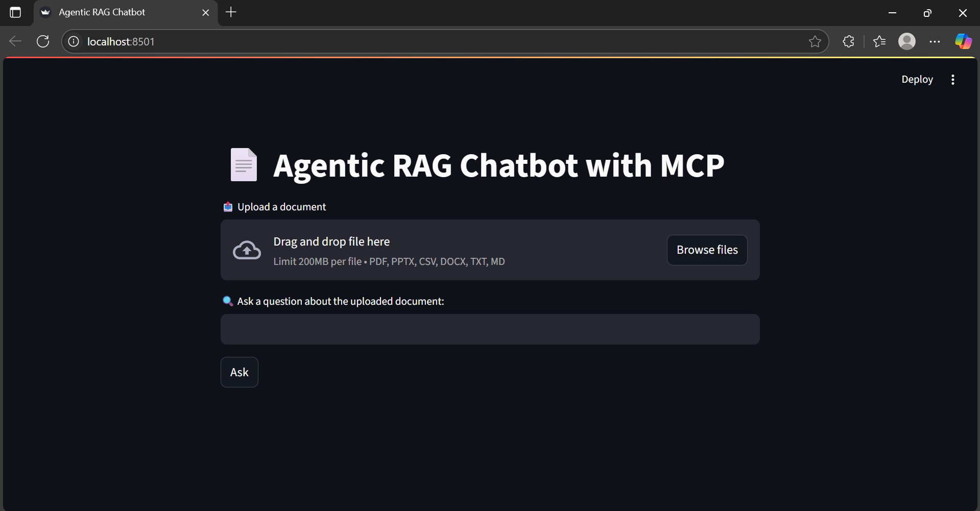

Slide 4
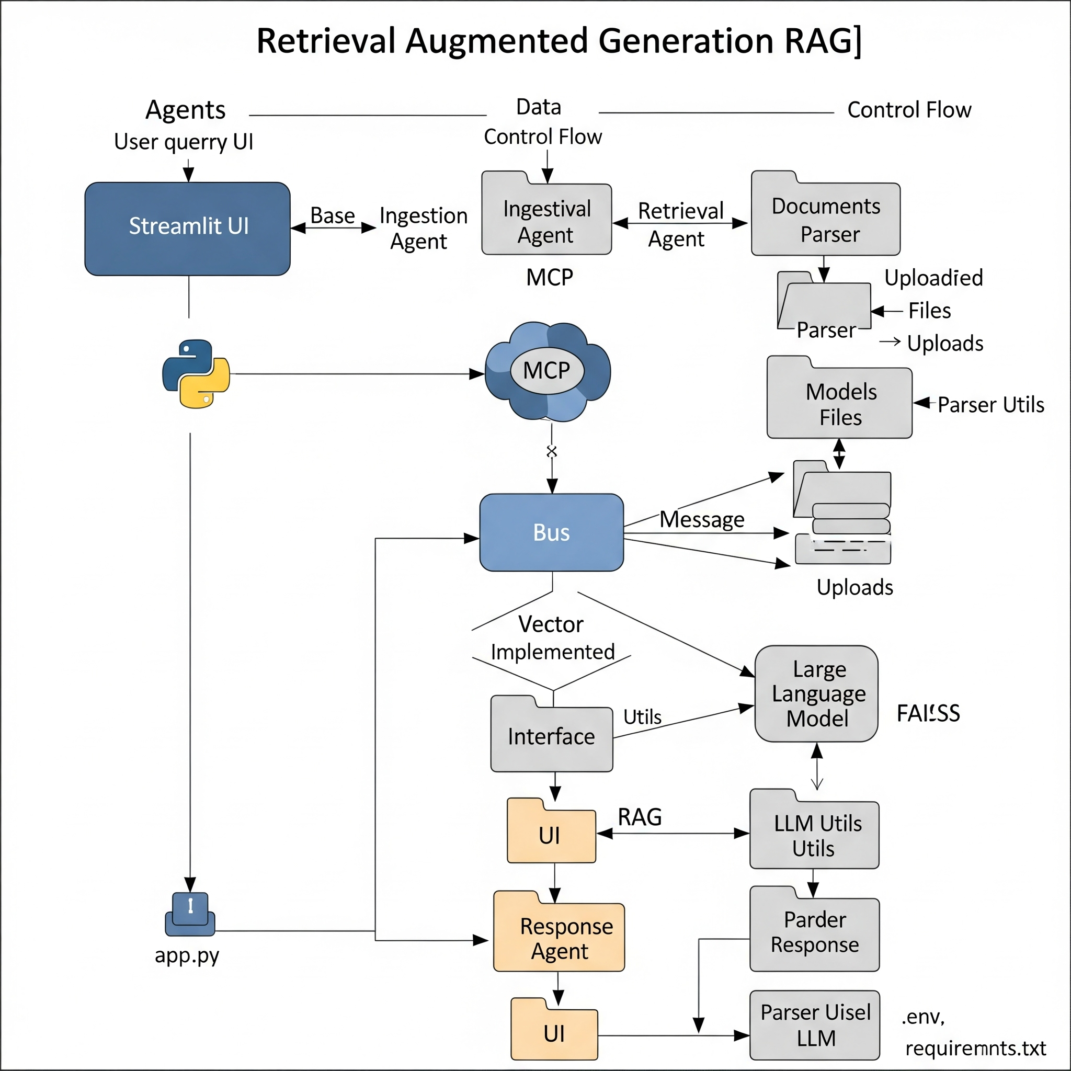
System Architecture
UI Layer (Streamlit): handles file uploads and user queries.
LLMResponseAgent: generates accurate answers.
MCP: message passing protocol between agents.
IngestionAgent: parses & chunks multi-format documents.
Vector Store (FAISS): stores document embeddings
RetrievalAgent: searches for relevant context.

Slide 5
Tech Stack
Tech Stack Used
Layer | Technology
UI | Streamlit
Backend | Python, LangChain
Vector DB | FAISS
Embeddings | SentenceTransformers / HuggingFace
LLM | FLAN-T5 / LLaMA / WizardLM (GGUF)
Document Parsing | PyMuPDF, python-docx, pandas, pptx
Orchestration | Model Context Protocol (MCP)

Slide 6
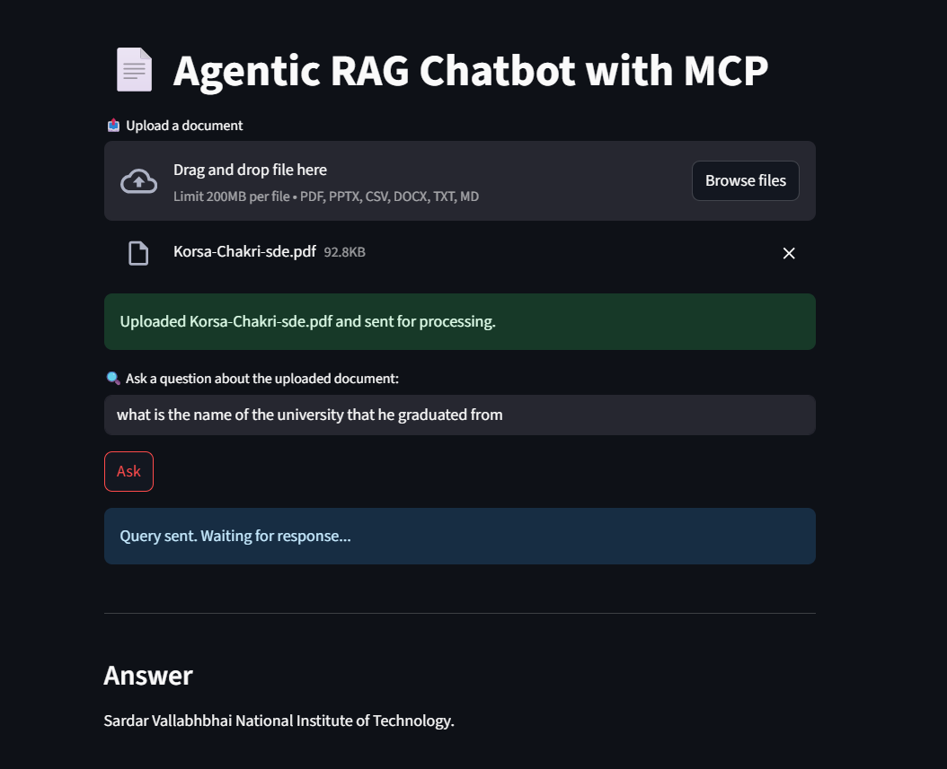
User Interface Preview

Slide 7
Challenges & Learnings/Future Scope
Challenges Faced
Integrating multiple file formats into a unified pipeline
Efficient chunking for large documents
Latency issues with large models on CPU (40s+ response)
Agent coordination and message passing using MCP
Learnings:
Deeper understanding of agentic workflows, LLMs, streaming UI, and semantic search.
Future Scope / Improvements
GPU support or model quantization for faster inference
Plug-in based custom agents (e.g., summarizer, verifier)
User personalization or memory support
Deploy as a full-stack app with FastAPI backend

